Slide 1
Dynamic Measurements

Slide 2
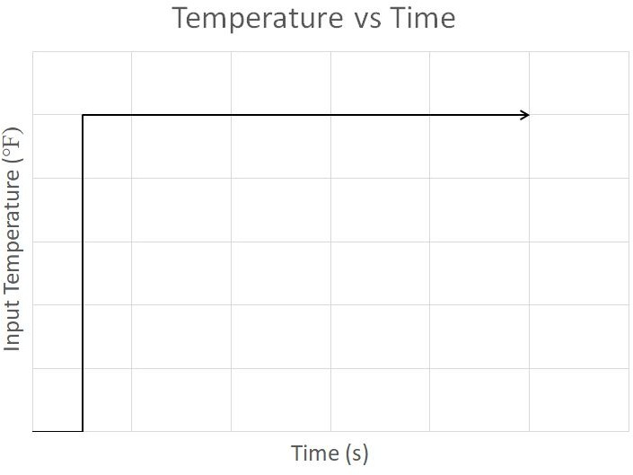
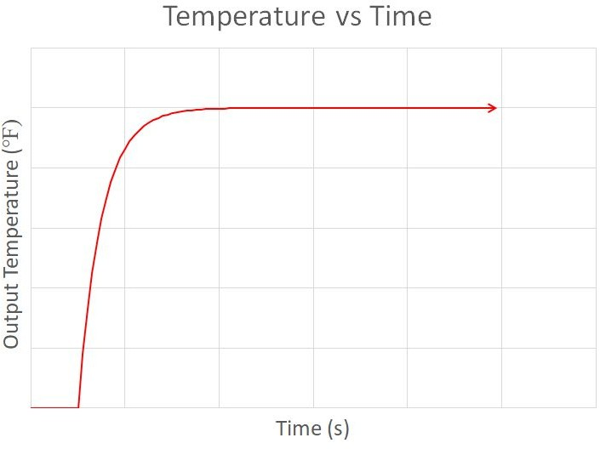
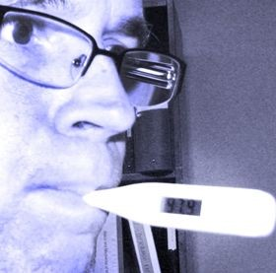
Dynamic Measurements
It often takes a measurement system time to reach equilibrium, even for static measurands (like when taking your temperature).
The situation is further complicated when the input temperature changes with time.

Slide 3
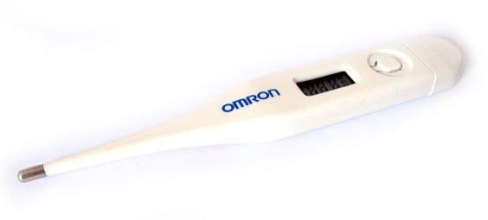



Dynamic Measurements
Heat transfer and energy absorption by thermometer bulb
$$=mc\frac{dT}{dt}$$
$$q=hA\left(T_{mouth}−T_{bulb}\right)$$
where
A = bulb surface area
c = heat capacity of bulb
h = heat transfer coefficient
m = mass of bulb
Time constant - As the mass of the bulb decreases, the response time decreases
Rearranging,
$$T_{mouth}−T_{bulb}=\frac{mc}{hA}\frac{dT}{dt}$$

Slide 4
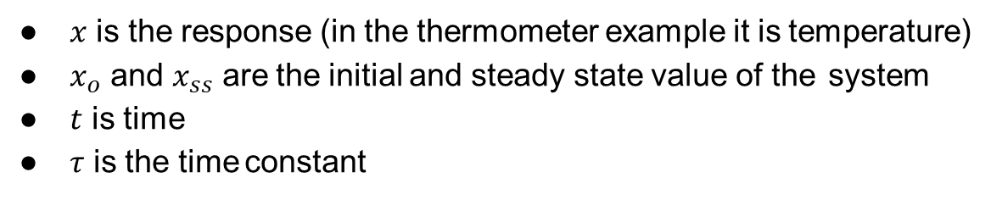




Dynamic Measurements
$$x_{ss}$$
$$τ=time constant= \frac{mc}{hA}$$
The thermometer is an example of a 1st order system. These systems have energy storage effects.
$$x_{0}$$
The solution to a 1st order system is
$$\frac{x\left(t\right)−x_{ss}}{x_{0}−x_{ss}}=e^{\frac{−t}{τ}}$$
where
$x$ is the response (in the thermometer example it is temperature)
$x_{o}$ and $x_{ss}$ are the initial and steady state value of the system
$t$ is time
$τ$ is the time constant
4/11

Slide 5

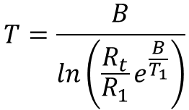
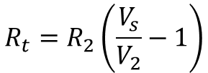
Example
Thermistor data here
$$V_{2}=aR\frac{5V}{1023}$$
ADC equation:
$$R_{t}=R_{2}\left(\frac{V_{s}}{V_{2}}−1\right)$$
Voltage divider equation:
Manufacturer’s Temperature equation:
$$T=\frac{B}{ln\left(\frac{R_{t}}{R_{1}}e^{\frac{B}{T_{1}}}\right)}$$

Slide 6
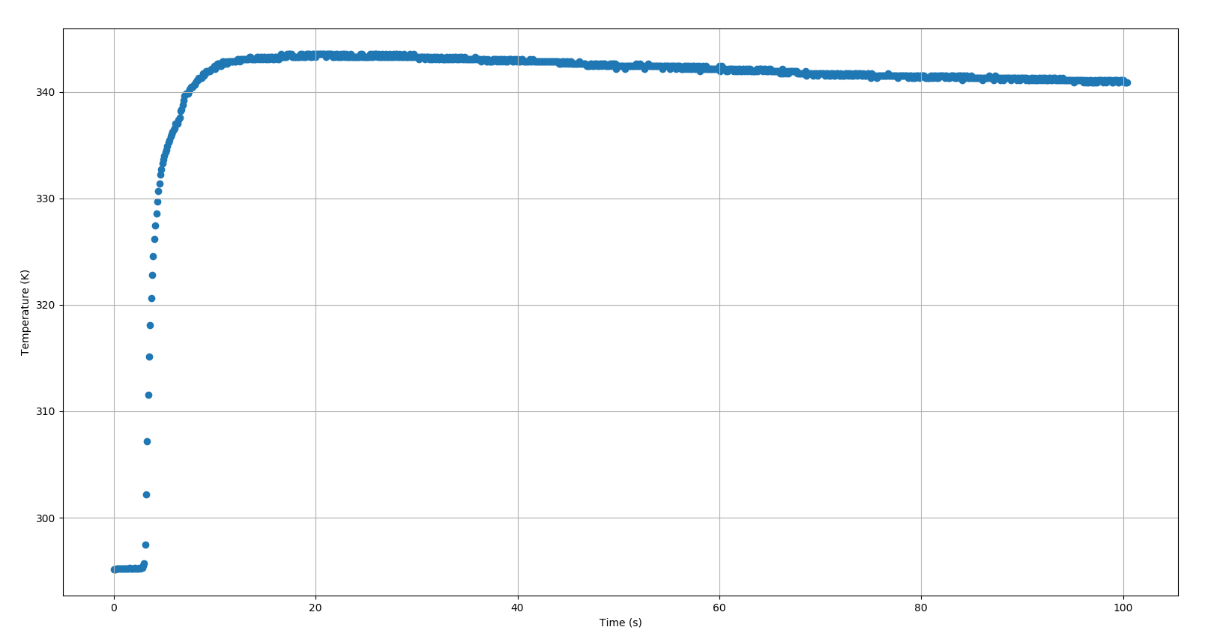


Example (contd.)
Take average of this portion for $x_{ss}$
$\sim 341.7 K$
Take average of this portion for $x_{0}$
$$\sim 295.2 K$$

Slide 7






Example (contd.)
$$\frac{x\left(t\right)−x_{ss}}{x_{0}−x_{ss}}=e^{\frac{−t}{τ}}$$
Special point in 1st order response equation.
when $t=τ$
$$\frac{x\left(τ\right)−x_{ss}}{x_{0}−x_{ss}}=e^{−1}≈0.3679$$
then
This is useful!
$$x\left(τ\right)≈0.3679\left(x_{0}−x_{ss}\right)+x_{ss}$$
$$x\left(τ\right)≈0.3679\left(295.2K−341.7K\right)+341.7K$$
$$x\left(τ\right)≈324.6K$$
Lookup $T=324.6K$ and find $t$. This give you $τ$.
$$τ≈3.92s$$

Slide 8
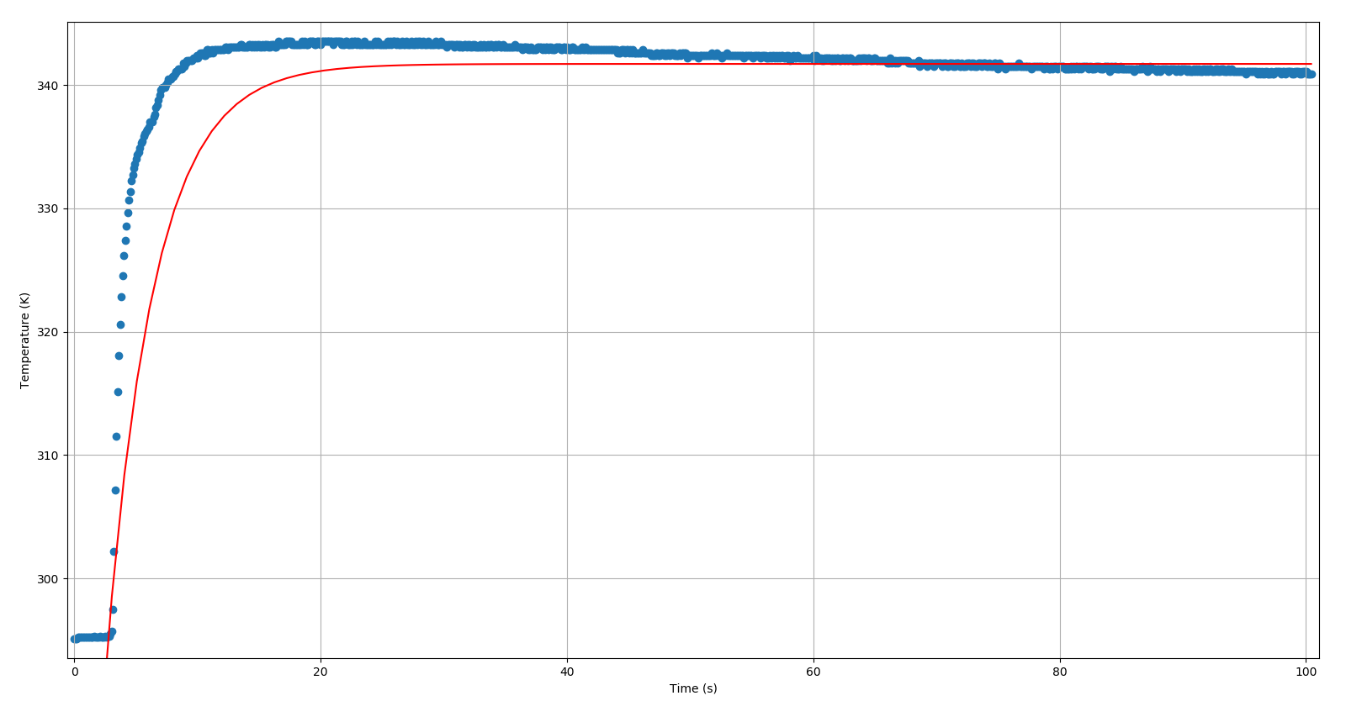
Example (contd.)
$$T=\left(295.2K −341.7K\right)e^{\frac{−t}{3.92s}}+341.7K$$

Slide 9

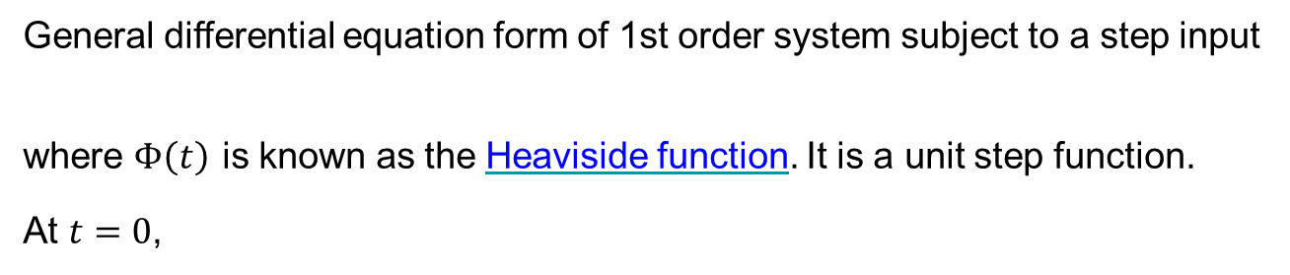



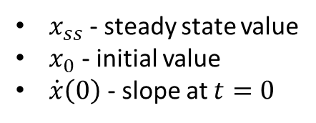
Dynamic Measurements
General differential equation form of 1st order system subject to a step input
where $Φ\left(t\right)$ is known as the Heaviside function. It is a unit step function.
At $t=0$,
$$τ\dot{x}\left(t\right)+x\left(t\right)=x_{ss}Φ\left(t\right)$$
$$τ\dot{x}\left(0\right)+x\left(0\right)=x_{ss}Φ\left(0\right)$$
$$τ\dot{x}\left(0\right)+x_{0}=x_{ss}$$
Solving for the time constant,
$$τ=\frac{x_{ss}−x_{0}}{\dot{x}\left(0\right)}$$
This is useful!
$x_{ss}$ - steady state value
$x_{0}$ - initial value
$\dot{x}\left(0\right)$ - slope at $t=0$

Slide 10
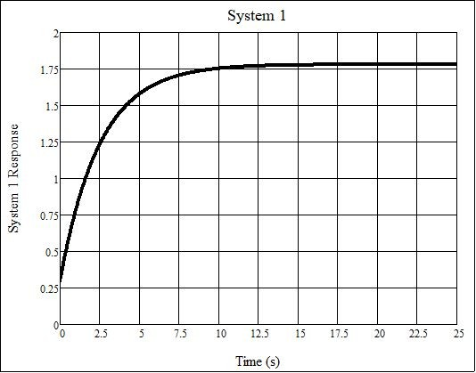
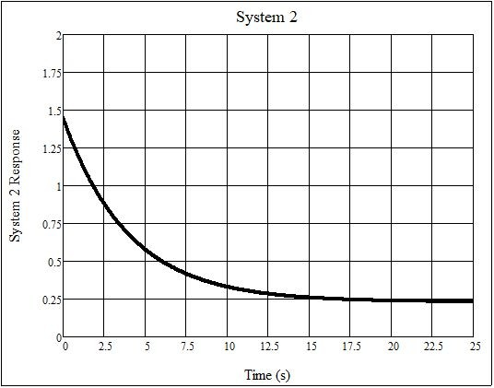
Example
The 1st order responses of two different systems subject to a step input are shown below. Which has the higher time constant? What are the response equations for each system?

Slide 11










System 1
System 2
From the plot
From the plot
$$x_{0}≈0.3$$
$$x_{0}≈1.4$$
$$\dot{x}\left(0\right)≈\frac{x_{2}−x_{1}}{t_{2}−t_{1}}≈\frac{0.5−1.4}{2.5−0}≈−0.36$$
$$x_{ss}≈1.8$$
$$x_{ss}≈0.25$$
For 1st Order system
For 1st Order system
$$τ_{2}=\frac{x_{ss}−x_{0}}{\dot{x}\left(0\right)}≈\frac{0.25−1.4}{−0.36}≈3.19s$$
$$\frac{x\left(t\right)−x_{ss}}{x_{0}−x_{ss}}=e^{\frac{−t}{τ}}$$
$$x_{2}\left(t\right)≈\left(1.4−0.25\right)e^{\frac{−t}{3.19s}}+0.25$$
When $t=τ$
$$x\left(τ\right)=\left(x_{0}−x_{ss}\right)e^{−1}+x_{ss}$$
System 2 has a larger time constant.
$$x\left(τ\right)≈\left(0.3−1.8\right)0.3679+1.8=1.25$$
On the plot where $x\left(τ\right)≈1.25$ then $t≈2.5s$
So $τ_{1}≈2.5s$ and $x_{1}\left(t\right)≈\left(0.3−1.8\right)e^{\frac{−t}{2.5s}}+1.8$
11/11

